Slide 1
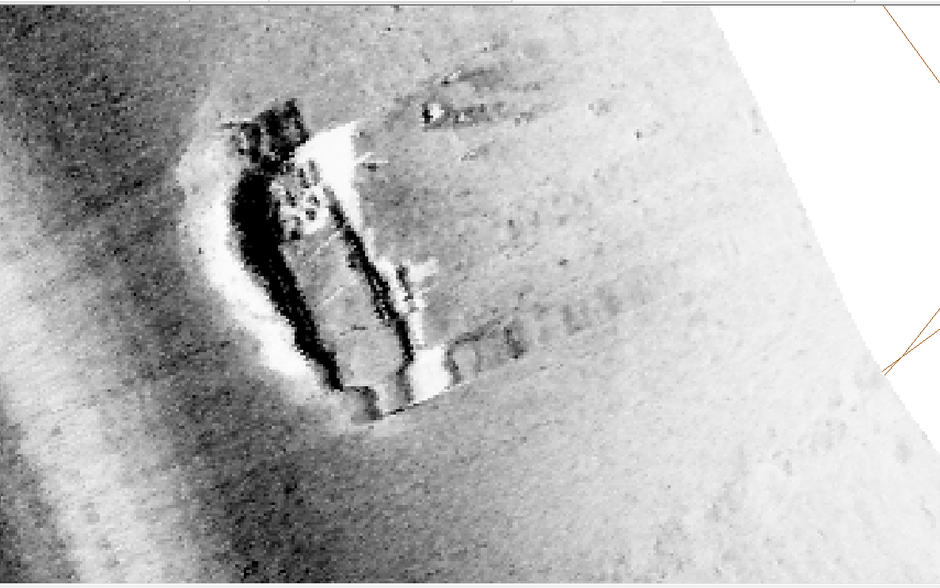
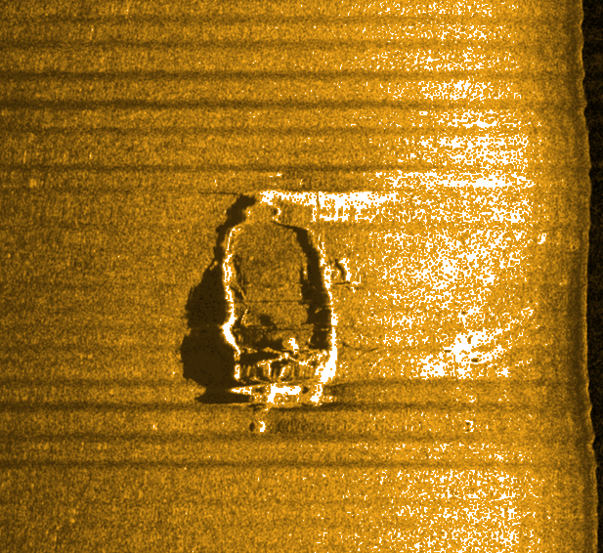
Y
Positions provided 2020-03-24
W
Z
V
x
x
V
Z
Y
W
OpenSidescan
V | 48.445608 | -68.828278
W | 48.445506 | -68.828260
X | 48.445614 | -68.828360
Y | 48.445711 | -68.828440
Z | 48.445670 | -68.828395
Caris
Sidescan file: scotsman5.xtf,
layback used: 27.53 meters

Slide 2
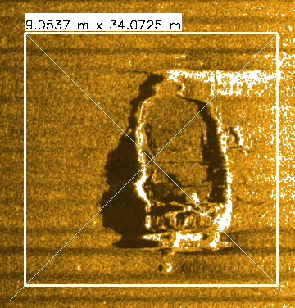
Y
Positions provided 2020-03-24
W
Point A: crossing of the green diagonal lines
Z
V
x
x
V
Z
Y
W
OpenSidescan
A | 48.445606 | -68.828392
Caris
Sidescan file: scotsman5.xtf,
layback used: 27.53 meters

